Slide 1
Proceeding beyond Diffraction Limit
Stochastic Optical Reconstruction Microscopy (STORM)-3D
CHS 818
-Abhik Bose, 154033002-
For slide and abstract Please visit http://abhik.space/presentations.html

Slide 2
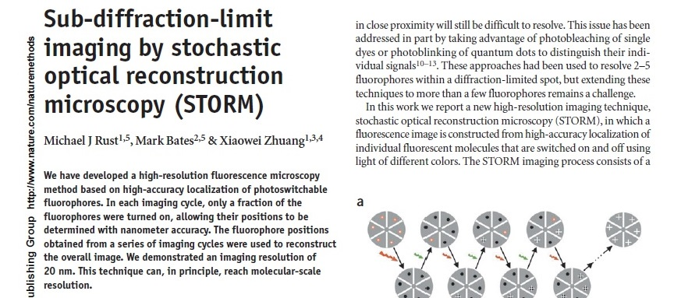

Slide 3
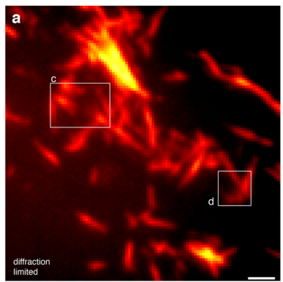
Optical Microscopy: Limitations
Abbe’s Diffraction limit
$$d=\frac{λ}{2nSinθ}=\frac{λ}{2 N.A.}=\sim 200nm$$

Slide 4
Way-out: Super resolution Microscopy or Nanoscopy:
Two approaches
Improved optics to achieve sub-wavelength resolution. Techniques include NSOM, SIM, STED etc.
Intelligent methodology to achieve super resolution with wide-field setup e.g. Localization Microscopy
Pros: High resolution super resolved image
Cones: Costly optics, Experimentally challenging.
Superresolved image with conventional wide-field setup

Slide 5
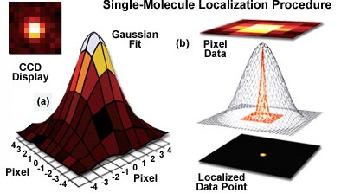
Localization Microscopy¹:
FROM: http://zeiss-campus.magnet.fsu.edu/articles/superresolution/introduction.html
$$f\left(x,y\right)=\frac{1}{2πσ_{x}σ_{y}}exp⁡\left(−\left(\frac{{(x−x_{0})}^{2}}{2σ_{x}^{2}}+\frac{{(y−y_{0})}^{2}}{2σ_{y}^{2}}\right)\right)$$
$σ_{x},σ_{y }$are the x and y spreads of the blob;
$(x_{0}$, $y_{0}$) is the centre;

Slide 6
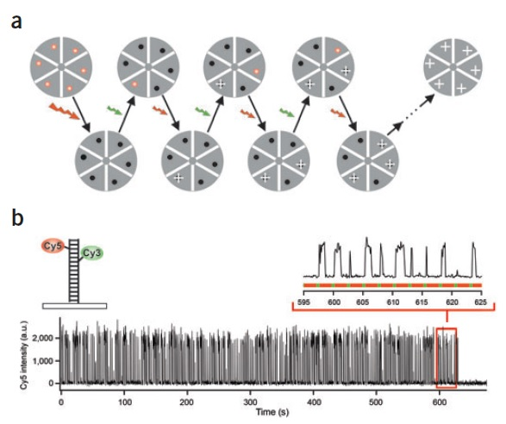
Stochastic Optical Reconstruction Microscopy²
Bates, M.; Blosser, T.R.; Zhuang, X. Phys. Rev. Lett. 2005, 94, 108101
Rust, M. J.; Bates, M.; Zhuang, X. Nat. Methods 2006, 3, 793

Slide 7
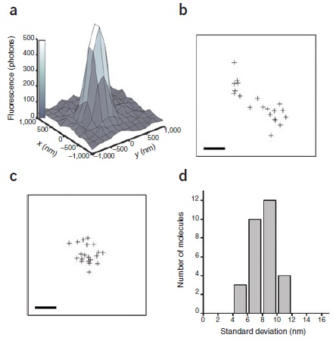
Localisation accuracy with STORM²

Slide 8
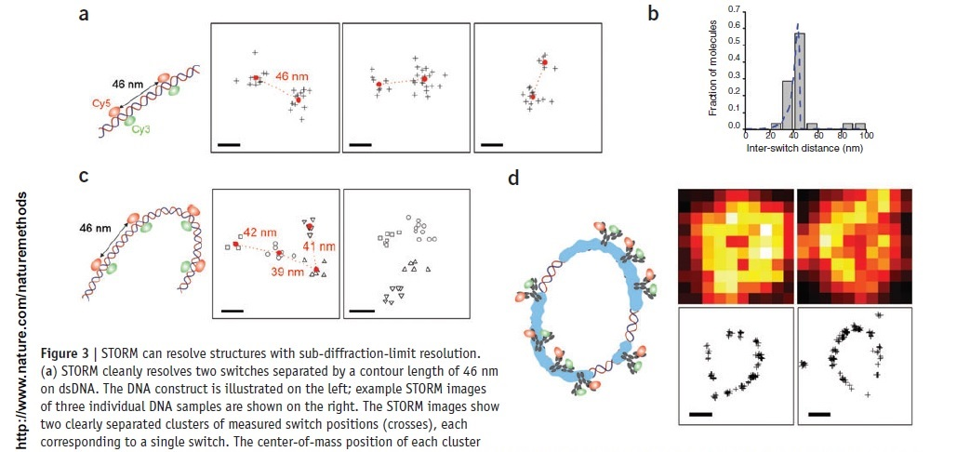
2D STORM Imaging with Cy5-Cy3 Switch²

Slide 9
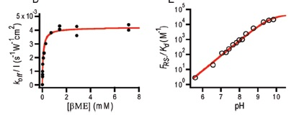
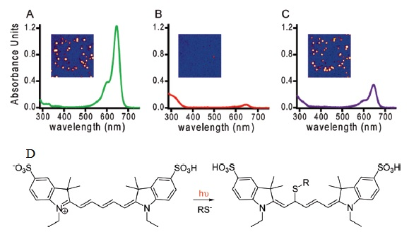
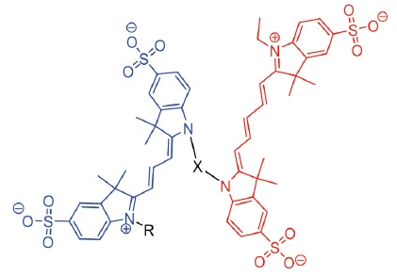
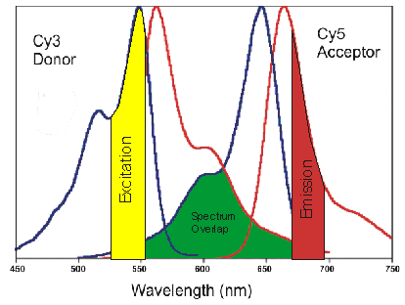
Photo switching Mechanism^{3,4}
Dempsey, . T.; Bates, M.; Kowtoniuk, W. E.; Liu, D. R.; Tsien, R. Y.; Chem. Soc. 2009, 131, 18192–18193.

Slide 10
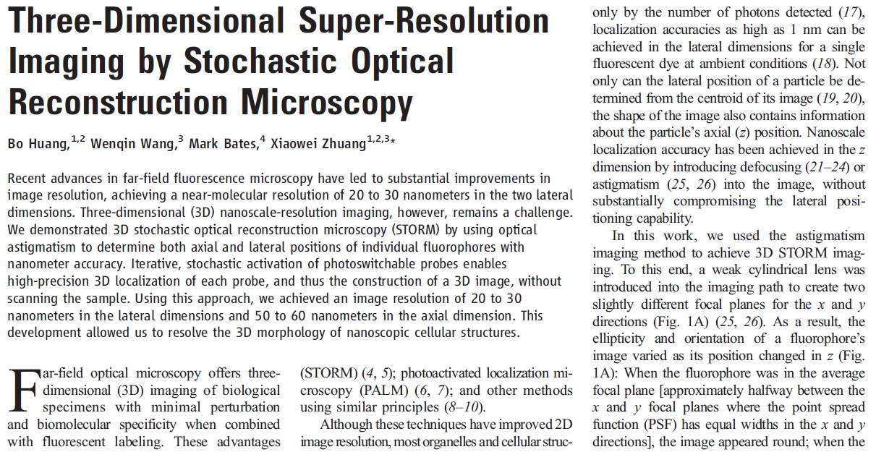
3D STORM Zhuang Science 2008

Slide 11
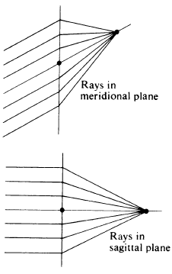
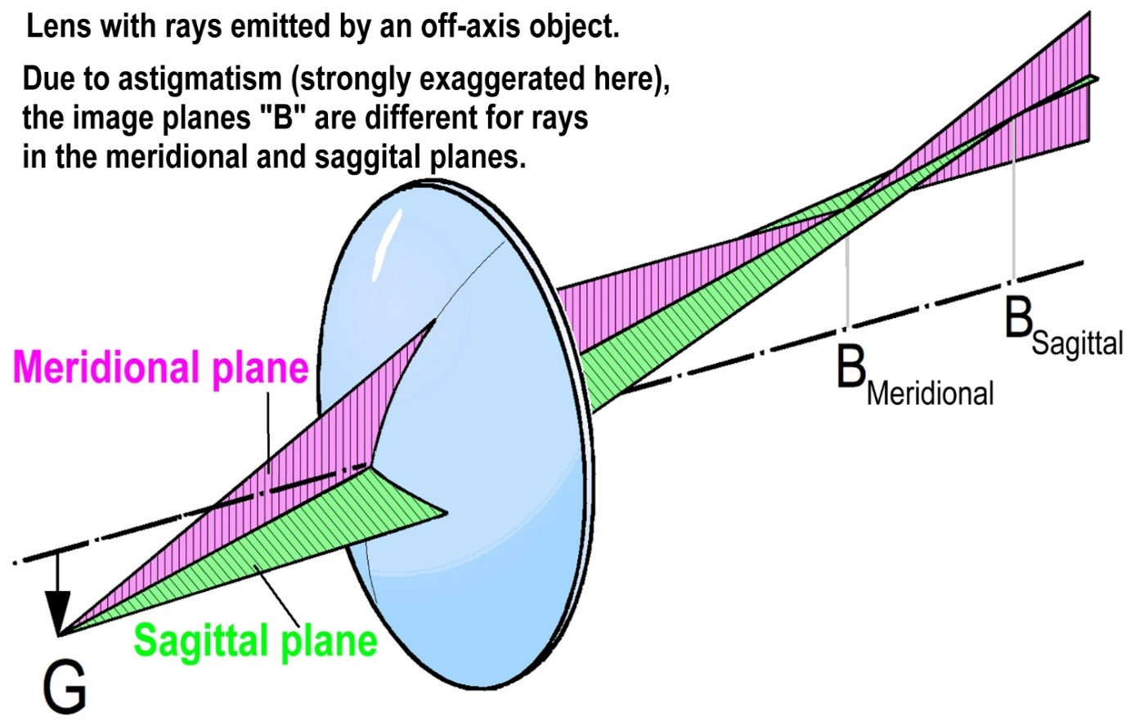
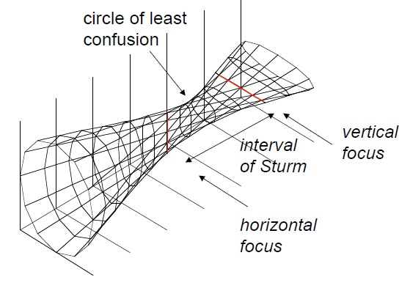
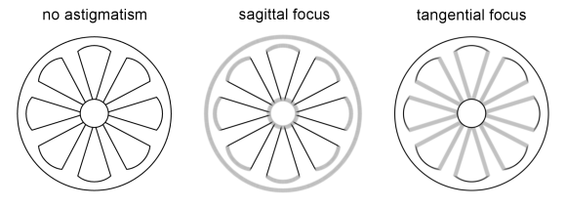
Astigmatism (monochromatic)
Source:
Optics by Hecht
4th edition.
Source: Internet
Propagation

Slide 12
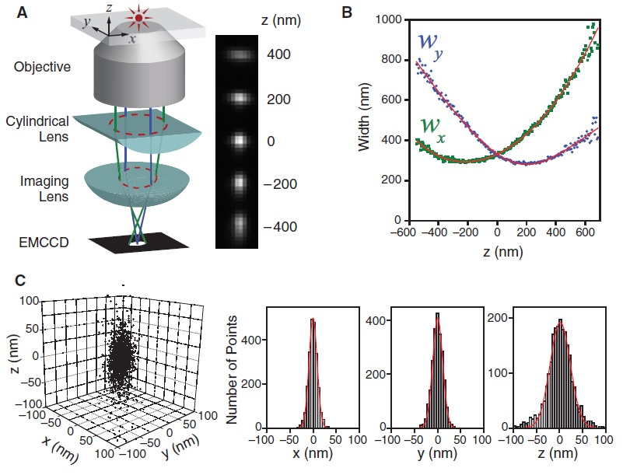
Astigmatism and 3D STORM Methodology⁶

Slide 13
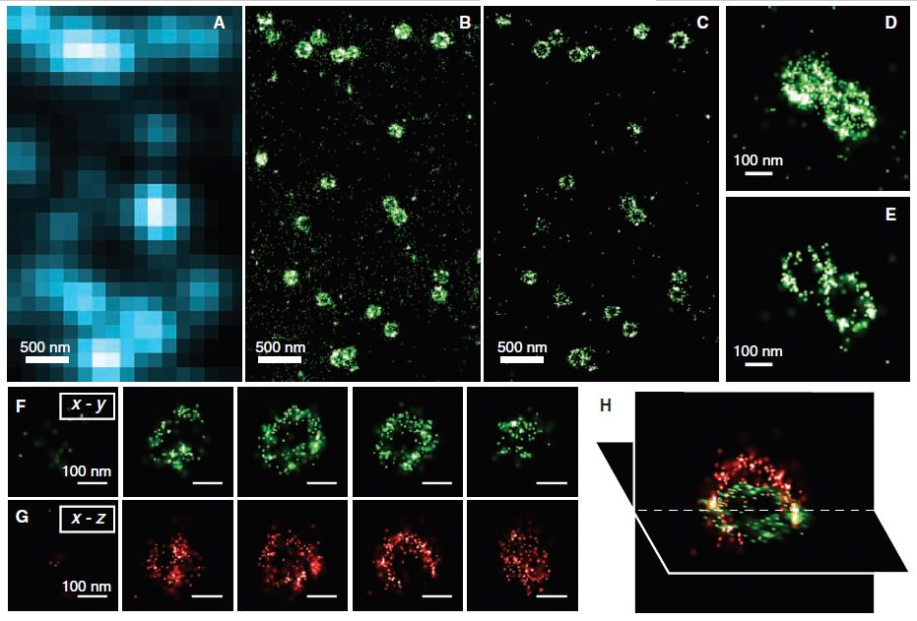
3D STORM Image⁶
Clathrin-coted pits in cell

Slide 14
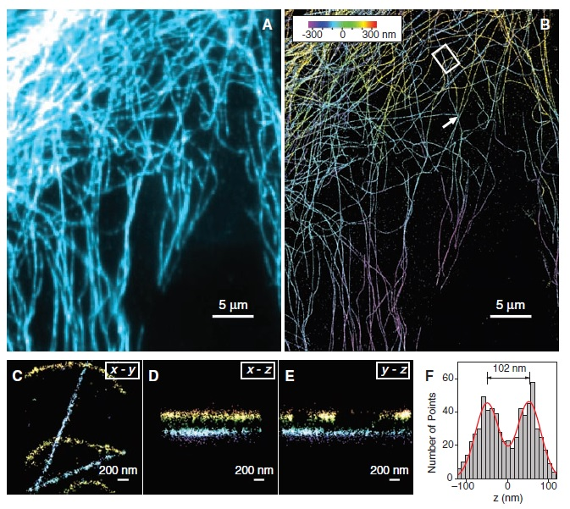
Re constructed image with 3D STORM⁶

Slide 15
Drawbacks
Upon invention STORM is a very successful method, but is dependent on storm specific dyes and the dye bleaches permanentely after a few hundreds of cycles. Invention of new dyes will remove this drawbacks.
References:
http://zeiss-campus.magnet.fsu.edu/articles/superresolution/introduction.html Accessed On: 13.04.2016 10:10 pm IST
Rust, M. J.; Bates, M.; Zhuang, X. Nat. Methods 2006, 3, 793.
Dempsey, G. T.; Bates, M.; Kowtoniuk, W. E.; Liu, D. R.; Tsien, R. Y.; Chem. Soc. 2009, 131, 18192–18193.
Bates, M.; Blosser, T.R.; Zhuang, X. Phys. Rev. Lett. 2005, 94, 108101
Dempsey, G. T.; Vaughan, J. C.; Chen, K. H.; Bates, M.; Zhuang, X. Nat. Methods 2011, 8, 1027–1036.
Huang, B.; Jones, S. A.; Brandenburg, B.; Zhuang, X. Nat. Methods 2008, 5, 1047–1052.

