Slide 1
Super Resolved Amyloid Imaging with Binding Activated Localisation Microscopy
CHS 802
Abhik Bose, 154033002, PhD 1St Year
Under the Guidence of Prof. Arindam Chowdhury
Chemistry, IIT Bombay
Slides: http://abhik.net/presentations.html

Slide 2
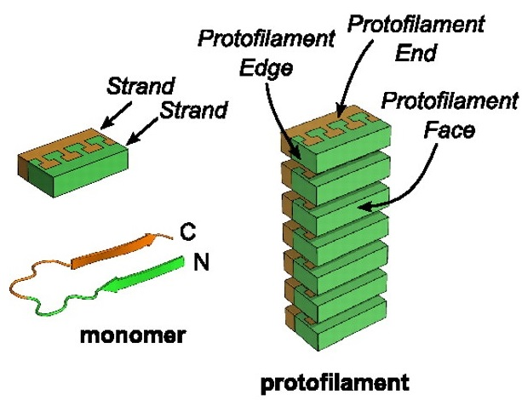
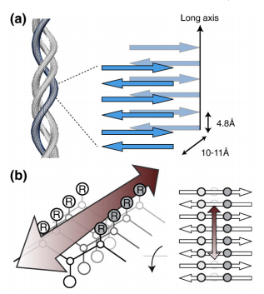
Amyloid Fibres
Insoluble protein aggregate,
causes diseases
Lack of crystal formation
So, conventional methods
like XRD, Liquid state
NMR etc. are not useful
Fluorescence spectroscopy
and microscopy, electron
microscopy, Atomic force
microscopy (AFM),
Circular Dichrosim (CD) etc.
Biochim. Biophys. Acta. 2010, 1804, 1405-1412.
Science. 2009, 325, 328 −332

Slide 3
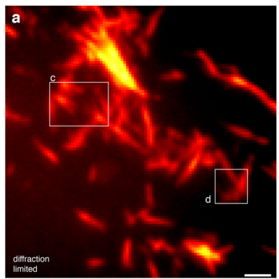
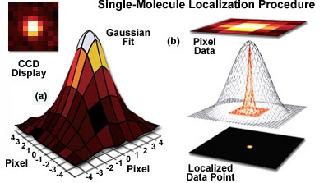
Towards super-resolution Microscopy
$$d=\frac{λ}{2nSinθ}=\frac{λ}{2 N.A.}=\sim 200nm$$
STED, NSOM, SIM | Localization Microscopy
Single emitter in a diffraction limited spot
Point spread function is fitted into Gaussian and the emitter is located preciously
$$f\left(x,y\right)=\frac{1}{2πσ_{x}σ_{y}}exp⁡\left(−\left(\frac{{(x−x_{0})}^{2}}{2σ_{x}^{2}}+\frac{{(y−y_{0})}^{2}}{2σ_{y}^{2}}\right)\right)$$
http://zeiss-campus.magnet.fsu.edu/articles/superresolution/introduction.html

Slide 4
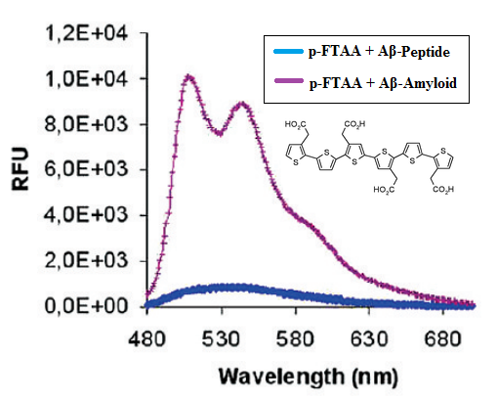
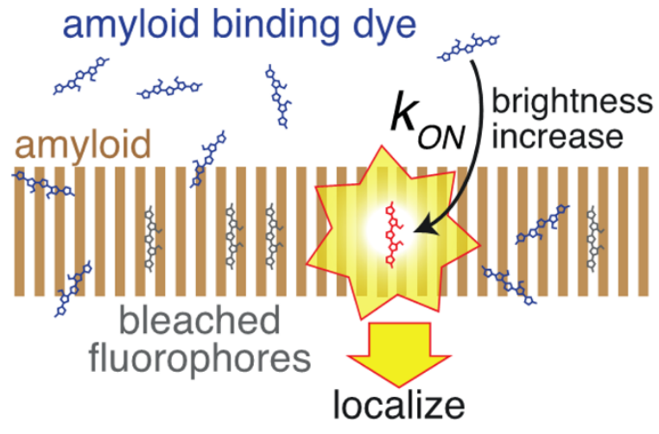
Photo blechable Amyloid Specific Dye &
Binding activated Localisation Microscopy (BALM):
Ries, J.; Udayar, Soragni, A. V.; Hornemann, S.; Nilsson, K. P.; Riek, R.; Hock, C.; Ewers, H.; Aguzzi, A. A.; Rajendran, L., ACS. Chem. Neurosci. 2013, 4, 1057-61
ACS Chem. Biol. 2009, 4, 673 −684

Slide 5
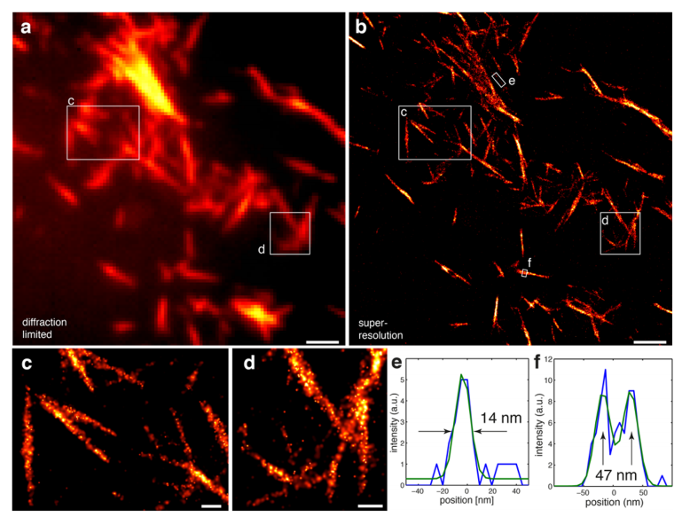
Amyloid Imaging with BALM:
ACS. Chem. Neurosci. 2013, 4, 1057-61

Slide 6
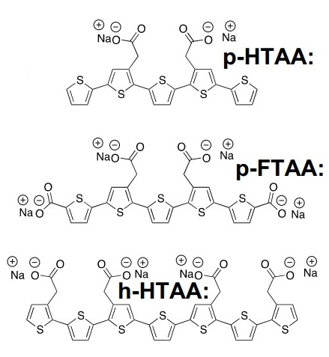
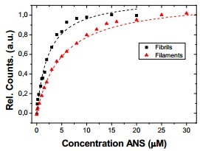
LCO vs. Conventional Dyes in Amyloid Morphology:
Aslund, A.; Sigurdson, C. J.; Klingstedt, T.; Grathwohl, S.; Bolmont, T.; Dickstein, D. L.; Glimsdal, E. D.; Prokop, S.; Lindgren, M. M.; Konradsson, P.; Holtzman, D. M.; Hof, P. R.; Heppner, F. L.; Gandy, S.; Jucker, M.; Aguzzi, A.; Hammarstro ̈m, P.; Nilsson, K. P. R., ACS Chem. Biol. 2009, 4, 673 −684

Slide 7
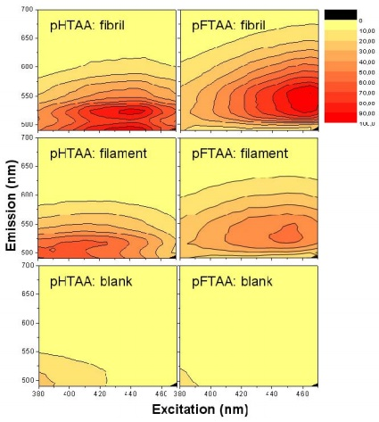
Emission-Excitation screening with LCO:
ACS Chem. Biol. 2009, 4, 673 −684

Slide 8
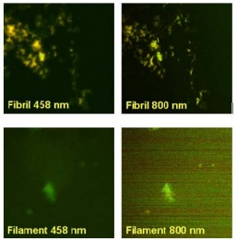
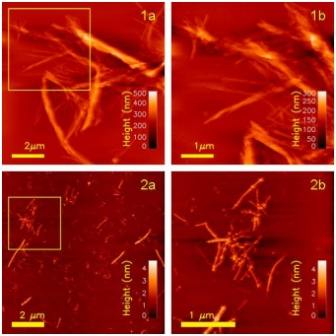
Diffraction limited vs. AFM image of insulin Amyloid (Fibril & Filament)
ACS Chem. Biol. 2009, 4, 673 −684

Slide 9
Pros of BALM over other techniques:
Sub-wavelength resolution up to ~20nm
No specialised optics
No pre straining so Increased signal to noise ratio
Monomer labelling with GFP or antibody isn’t required
Performed in physiological like buffer condition
Structure-morphology-toxicity relationship
Future Possibilities:
Realizing structure-morphology-toxicity relationship
May be easily extended into invivo condition
Amyloidosis drug design

