Slide 1
Superresolution imaging of Amyloid Fibre with Binding Activated Localisation Microscopy
CHS 802
Submitted By: Abhik Bose, 154033002, PhD 1St Year
Under the Guidence of Prof. Arindam Chowdhury
Chemistry, IIT Bombay

Slide 2
Amyloid Fibres
Insoluble protein aggregate, causes diseases
Lack of crystal formation
So, conventional methods like XRD, Liquid state NMR etc. are not useful
Fluorescence based spectroscopy and microscopy, electron microscopy, Atomic force microscopy (AFM), Circular Dichrosim (CD) etc.

Slide 3
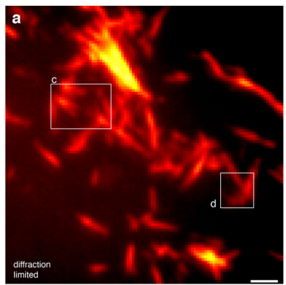
Optical Microscopy: Limitations
Abbe’s Diffraction limit
$$d=\frac{λ}{2nSinθ}=\frac{λ}{2 N.A.}=\sim 200nm$$
Figure 1: Conveentional microscopy based blurred image of α-Synuclein Amyloid Fiibre¹

Slide 4
Way-out: Superresolution Microscopy or Nanoscopy: Two approaches
Improved optics to achieve sub-wavelength resolution. Techniques include NSOM, SIM, STED etc.
Intelligent methodology to achieve super resolution with wide-field setup e.g. Localization Microscopy
Pros: High resolution superresolved image
Cones: Costly optics, Experimentally challenging.
Superresolved image with wide-field setup
Experimental flexibility
But experiment is to be specially designed.

Slide 5
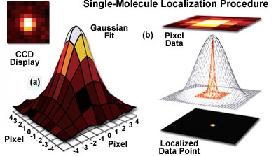
Localization Microscopy:
Single emitter in a diffraction limited spot
Point spread function is fitted into Gaussian and the emitter is located preciously
Figure 2: diffraction limited image of amyloid fibre²
$$f\left(x,y\right)=\frac{1}{2πσ_{x}σ_{y}}exp⁡\left(−\left(\frac{{(x−x_{0})}^{2}}{2σ_{x}^{2}}+\frac{{(y−y_{0})}^{2}}{2σ_{y}^{2}}\right)\right)$$
$σ_{x},σ_{y }$are the x and y spreads of the blob;
$(x_{0}$, $y_{0}$) is the centre;

Slide 6
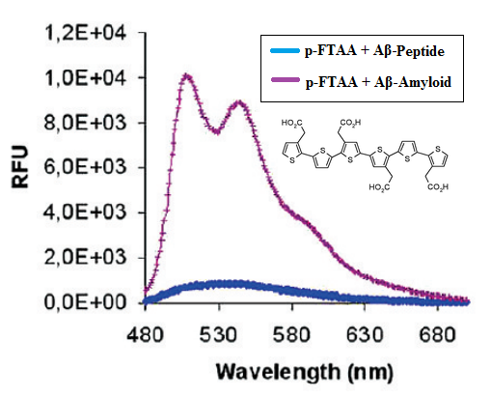
Photoblechable Amyloid Specific Dye:
Conventional Dyes: Photostable e.g. ThT, Congo Red etc.
Luminescent conjugated oligothiophens (LCOs)
Photoblechable
pentamer-formyl thiophene acetic acid (p-FTAA) is one good example
Figure 5: Fluorescence emission spectra of p-FTAA with Aβ-Amyloid³

Slide 7
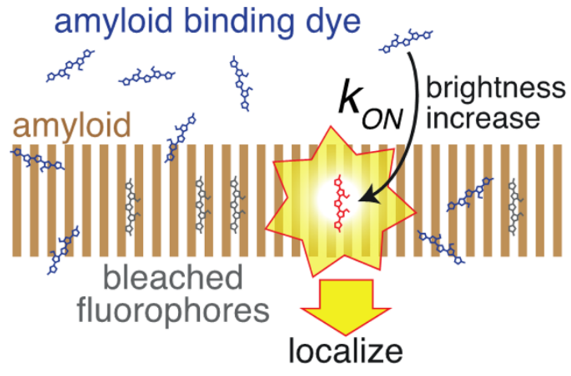
Binding Activated Localization Microscopy (BALM)
Low concentration of Dye molecule
Stochastic binding, Activation and localization
Photo bleaching
Figure 6: Stochastic binding of dye molecule¹
New dye molecule occupy vacant site of the Amyloid
This repeats until all binding sites are filled by bleached dye
Fitting the PSI into Gaussian and combination of all the frames reconstruct the superresolved image

Slide 8
Pros of BALM over other techniques:
Sub-wavelength resolution up to ~20nm
No specialised optics
No pre straining of amyloid fibre
Monomer labelling with GFP or antibody isn’t required
Increased signal to noise ratio
Performed in physiological like buffer condition

Slide 9
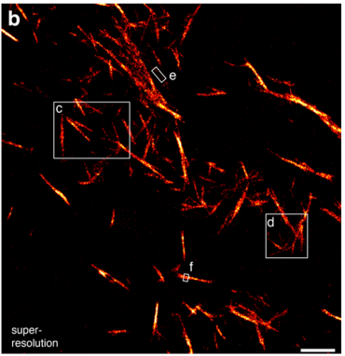
Coming usefules in Final presentation:
Analysis of BALM data for
α-Synuclein Amyloid fibre
Comparison of BALM with other
Superresolution techniques
Exploring it’s application in
different fields
Figure 7: Superresolution Image with BALM¹

Slide 10
References:
Ries, J.; Udayar, Soragni, A. V.; Hornemann, S.; Nilsson, K. P.; Riek, R.; Hock, C.; Ewers, H.; Aguzzi, A. A.; Rajendran, L., ACS. Chem. Neurosci. 2013, 4, 1057-61
http://zeiss-campus.magnet.fsu.edu/articles/superresolution/introduction.html
Aslund, A.; Sigurdson, C. J.; Klingstedt, T.; Grathwohl, S.; Bolmont, T.; Dickstein, D. L.; Glimsdal, E. D.; Prokop, S.; Lindgren, M. M.; Konradsson, P.; Holtzman, D. M.; Hof, P. R.; Heppner, F. L.; Gandy, S.; Jucker, M.; Aguzzi, A.; Hammarstro ̈m, P.; Nilsson, K. P. R., ACS Chem. Biol. 2009, 4, 673 −684
Thank You

